Slide 1



SQL Server Temporal Tables
in EF Core 6.0

Slide 2
Table of contents
Who am I?
What is SQL Server Temporal Table?
Configuring a temporal table
Using temporal tables
Querying historical data
Restoring historical data

Slide 3
Who am i?
Currently:
CTO at Aspian Company
Instructor at FAD Institute
Formerly:
Principal Software Consultant at Ports & Maritime Org of Iran
SQL Server Consultant at The Railways Org of Iran
Instructor at MFT & Cybertech Institutes

Slide 4
What is SQL Server Temporal Tables?
SQL Server temporal tables automatically keep track of all data ever stored in a table, even after that data has been updated or deleted using a parallel history table
Using history table, we can query the historical data, or even we can restore them
EF Core now supports:
The creation of temporal tables using Migrations
Transformation of existing tables into temporal tables, again using Migrations
Querying historical data
Restoring data from some point in the past

Slide 5
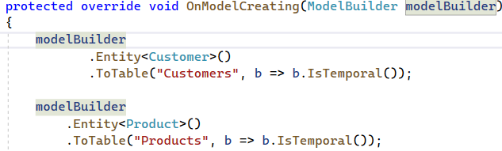
Configuring a temporal table
Modelbuilder can be used for configuring Temporal Table
If not specified, Modelbuilder will use SQL Server defaults for history table and timestamp columns
Period Columns: By default PeriodStart and PeriodEnd, represent the time range during which the data in the row existed

Slide 6
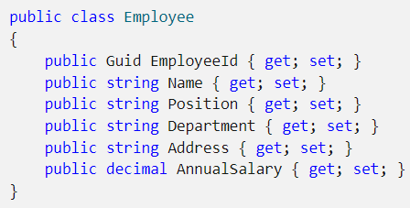
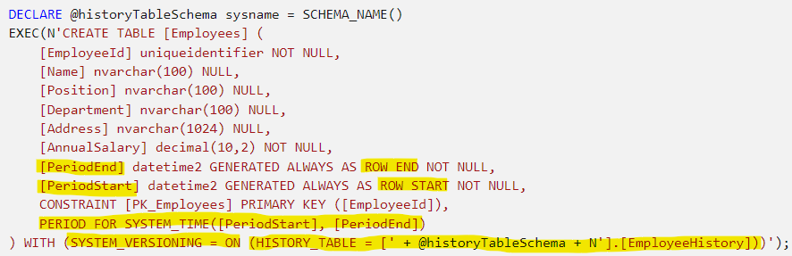
Configuring a temporal table

Slide 7
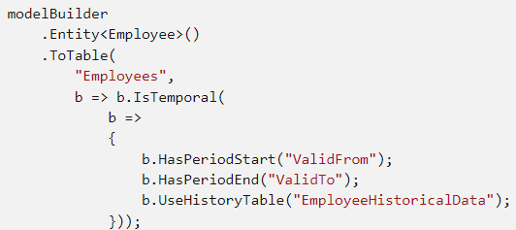
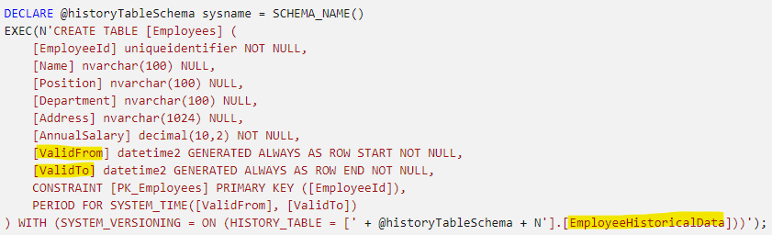
Configuring a temporal table

Slide 8
Using Temporal Tables
Most of the time, temporal tables are used just like any other table
the period columns and historical data are handled transparently by SQL Server such that the application can ignore them
EF.Property method can be used to access values from the period columns.
After a normal tracking query, the values from the period columns of the current data can be accessed from the tracked entities
The times in Period columns are always UTC time generated by SQL Server

Slide 9

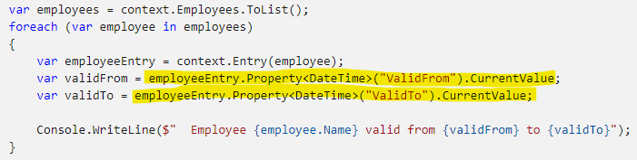
Using Temporal Tables

Slide 10
Querying historical data
TemporalAsOf: Returns rows that were active (current) at the given UTC time. This is a single row from the history table for a given primary key.
TemporalAll: Returns all rows in the historical data. This is typically many rows from the history table for a given primary key.
TemporalFromTo: Returns all rows that were active between two given UTC times. This may be many rows from the history table for a given primary key.
TemporalBetween: The same as TemporalFromTo, except that rows are included that became active on the upper boundary.
TemporalContainedIn: : Returns all rows that started being active and ended being active between two given UTC times. This may be many rows from the history table for a given primary key.

Slide 11
Querying historical data
TemporalAsOf: Returns rows that were active (current) at the given UTC time. This is a single row from the history table for a given primary key.
TemporalAll: Returns all rows in the historical data. This is typically many rows from the history table for a given primary key.
TemporalFromTo: Returns all rows that were active between two given UTC times. This may be many rows from the history table for a given primary key.
TemporalBetween: The same as TemporalFromTo, except that rows are included that became active on the upper boundary.
TemporalContainedIn: : Returns all rows that started being active and ended being active between two given UTC times. This may be many rows from the history table for a given primary key.

Slide 12
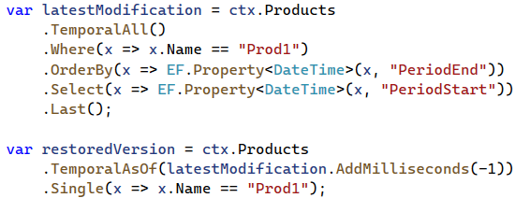
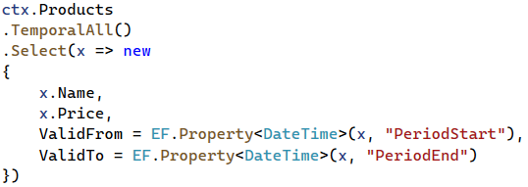
Querying historical data

Slide 13
Restoring historical data
All queries using temporal operators are no-tracking by default. This makes sense, because they do not currently exist in the main table. To re-insert the entity into the main table, we simply mark it as Added and then call SaveChanges.

Slide 14
How to Contact me
Twitter: @_Jinget
LinkedIn: VFarahmandian
GitHub: VahidFarahmandian
Instagram: VahidFarahmandian
Email: farahmandian2011@gmail.com

